Slide 1
LEARN THEM EASY
To create application for a readable document to speech. The application can convert any word or pdf documents to human understandable voice format. Here we can select a readable file and convert to audio file.

Slide 2
Technology:
Front end : html,css,js
Back end : Django

Slide 3
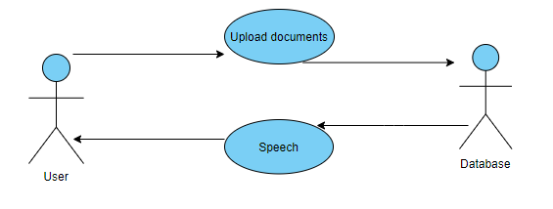
Use Case: Readable document to audio document
When the user once upload the file it can find if it is readable or not. If it is not readable it leave that. Otherwise it convert to speech.

